Slide 1
Network Protocols & Security
[22EC2210R]
CO-1
Medium Access Control Sub layer: Channel allocation problem, multiple access protocols, Ethernet

Slide 2
AIM OF THE SESSION
The aim of this course is to familiarize students with the concepts and mechanisms of multiple access protocols. Students will gain a deep understanding of the challenges involved in sharing communication channels among multiple users and the strategies employed by different protocols to ensure efficient and fair access.
INSTRUCTIONAL OBJECTIVES
Understand the principles of multiple access and its significance in modern communication networks.
Identify and differentiate between various multiple access protocols.
Analyze the performance characteristics of different multiple access protocols.
Design and evaluate multiple access protocols for specific network scenarios.
Assess the impact of multiple access protocols on network efficiency, fairness, and quality of service.
LEARNING OUTCOMES
Upon completion of this course, students will:
Demonstrate a comprehensive understanding of multiple access protocols and their applications.
Apply analytical and modeling techniques to evaluate the performance of multiple access protocols.
Design and simulate multiple access protocols to meet specific network requirements.
Critically evaluate the advantages and limitations of different multiple access techniques.
Communicate effectively about multiple access protocols and their implications in network design and operation.

Slide 3
AGENDA
Data Link Layer
Multiple Access Protocols
Random Access Protocols
Controlled Access Protocols
Channelization
Features of Multiple Access Protocols

Slide 4
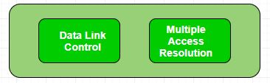
Data Link Layer
The Data Link Layer is responsible for transmission of data between two nodes. Its main functions are-
Data Link Control
Multiple Access Control

Slide 5
Data Link Layer
Data Link control – The data link control is responsible for reliable transmission of message over transmission channel by using techniques like framing, error control and flow control. For Data link control refer to – Stop and Wait ARQ
Multiple Access Control – If there is a dedicated link between the sender and the receiver then data link control layer is sufficient, however if there is no dedicated link present then multiple stations can access the channel simultaneously. Hence multiple access protocols are required to decrease collision and avoid crosstalk.

Slide 6
Random Access Protocols
Random Access Protocol: In this, all stations have same superiority that is no station has more priority than another station. Any station can send data depending on medium’s state( idle or busy). It has two features:
There is no fixed time for sending data
There is no fixed sequence of stations sending data
The Random access protocols are further subdivided as:
ALOHA
Pure
Slotted
CSMA
CSMA/CD
CSMA/CA

Slide 7
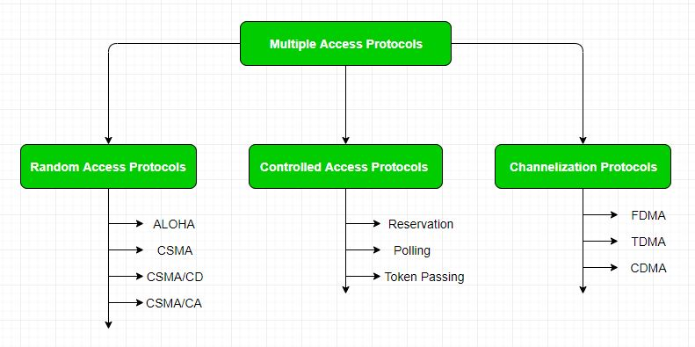
Multiple access protocols
Multiple access protocols can be subdivided further as –

Slide 8
Controlled Access Protocols
In this, the data is sent by that station which is approved by all other stations
Protocols:
Reservation
Polling
Token Passing

Slide 9
Channelization
In this, the available bandwidth of the link is shared in time, frequency and code to multiple stations to access channel simultaneously.
Frequency Division Multiple Access (FDMA)
Time Division Multiple Access (TDMA)
Code Division Multiple Access (CDMA)
Orthogonal Frequency Division Multiple Access (OFDMA)
Advantages:
Increase in efficiency
High data rates
Good for multimedia traffic
Disadvantages:
Complex to implement
High peak to power ratio

Slide 10
Channelization
Spatial Division Multiple Access (SDMA)
Advantages :
Frequency band uses effectively
The overall signal quality will be improved
The overall data rate will be increased
Disadvantages :
It is complex to implement
It require the accurate information about the channel

Slide 11
Features of Multiple Access Protocols
Contention-based access: Multiple access protocols are typically contention-based, meaning that multiple devices compete for access to the communication channel. This can lead to collisions if two or more devices transmit at the same time, which can result in data loss and decreased network performance.
Carrier Sense Multiple Access (CSMA): CSMA is a widely used multiple access protocol in which devices listen for carrier signals on the communication channel before transmitting. If a carrier signal is detected, the device waits for a random amount of time before attempting to transmit to reduce the likelihood of collisions.

Slide 12
Features of Multiple Access Protocols
Collision Detection (CD): CD is a feature of some multiple access protocols that allows devices to detect when a collision has occurred and take appropriate action, such as backing off and retrying the transmission.
Collision Avoidance (CA): CA is a feature of some multiple access protocols that attempts to avoid collisions by assigning time slots to devices for transmission.
Token passing: Token passing is a multiple access protocol in which devices pass a special token between each other to gain access to the communication channel. Devices can only transmit data when they hold the token, which ensures that only one device can transmit at a time.

Slide 13
Features of Multiple Access Protocols
7. Bandwidth utilization: Multiple access protocols can affect the overall bandwidth utilization of a network. For example, contention-based protocols may result in lower bandwidth utilization due to collisions, while token passing protocols may result in higher bandwidth utilization due to the controlled access to the communication channel.

Slide 14
SELF-ASSESSMENT QUESTIONS
What is the purpose of multiple access protocols in communication networks?
What are the two main categories of multiple access protocols?
What is the primary drawback of contention-based multiple access protocols?
What is the role of the MAC layer in wireless networks?
What is the advantage of controlled-access multiple access protocols?

Slide 15
REFERENCES FOR FURTHER LEARNING OF THE SESSION
Reference Books:
1. Data Communications and Networking, Behrouz A. Forouzan, 4th Edition, McGraw Hill.
2. Computer Networks, Tanenbaum, 6th Edition, Pearson.
Sites and Web links:
CISCO Academy
NPTEL, Computer Networks and Internet Protocols, Prof. Soumya Kanti Ghosh, Prof. Sandip Chakraborty IIT Kharagpur. (https://nptel.ac.in/courses/106105183)

Slide 16

THANK YOU
Team – Networks Protocols & Security

